Slide 1


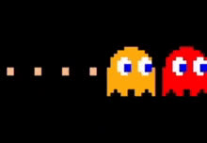


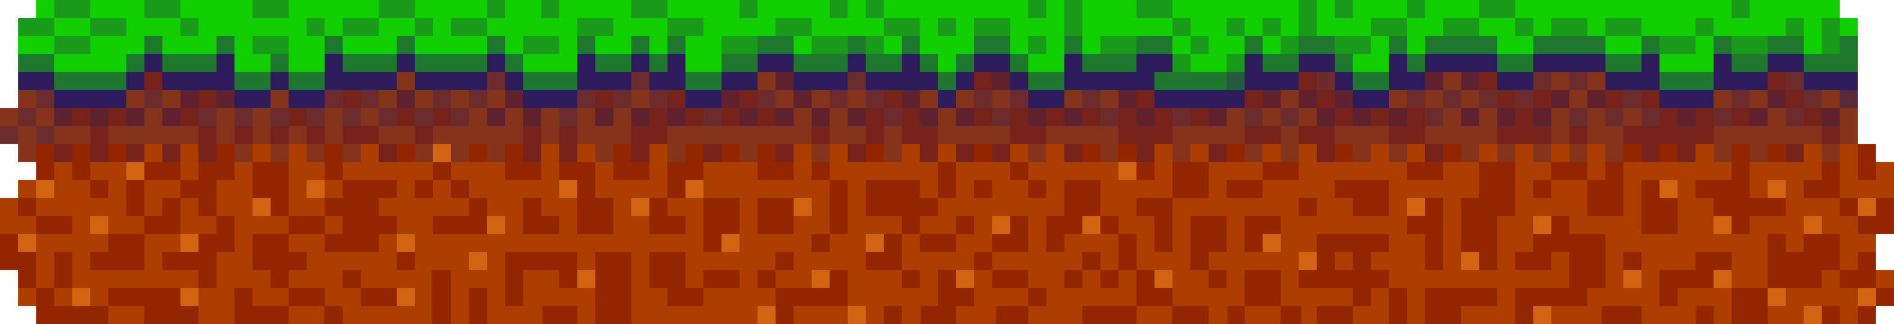
LET'S PLAY THE
PACMAN
game

Slide 2
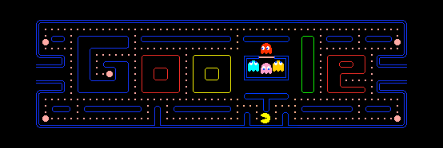

ABOUT GAME
This game is a small Pac-Man project. Pac-Man moves in a maze and collects dots. Two ghosts follow him using BFS and greedy search algorithms. The game shows the ghosts’ paths, the score, and ends when Pac-Man wins or loses.
More Information

Slide 3

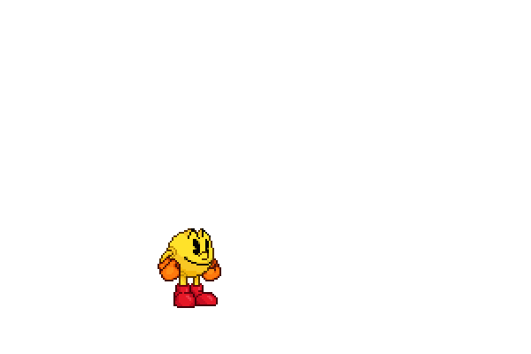
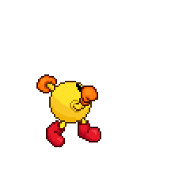

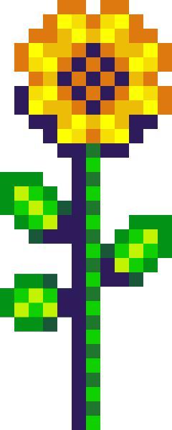
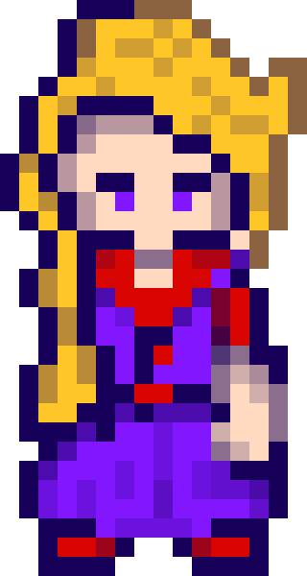

HOW TO PLAY THIS GAME?
Use arrow keys to move Pac-Man.
Collect every dot.
Touching a ghost ends the game instantly.

Slide 4


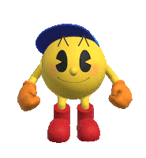
AI SEARCH ALGORITHMS USED
1. BFS (Breadth-First Search)
• Guarantees shortest path
• Explores evenly in all directions
2. Greedy Best-First Search
• Chooses move with smallest Manhattan distance
• Faster but not always optimal

Slide 5
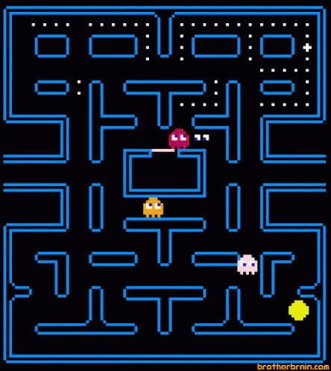
HOW GHOSTS PURSUE PAC-MAN
1• Each ghost uses its own search algorithm
• Ghost 1 calculates a full BFS path to Pac-Man
• Ghost 2 chooses greedy steps with minimal distance
• Algorithms update every few frames to simulate intelligence

Slide 6
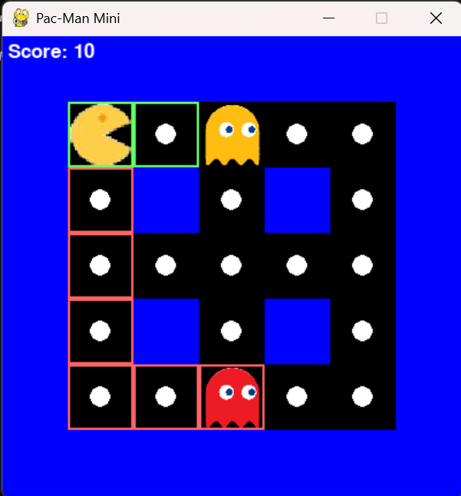

REAL-TIME PATH VISUALIZATION
The game displays each ghost’s computation visually:
• BFS Path → Red line
• Greedy Path → Green line
Visualization helps compare how each algorithm searches the maze.

Slide 7

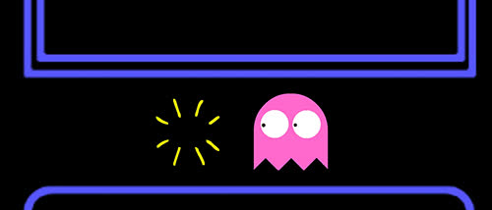
COMPARATIVE ANALYSIS
BFS:
• Always finds shortest path
• More accurate
• Slower (explores many nodes)
Greedy:
• Faster decision-making
• Fewer explored nodes
• Not always the shortest path
• Can get stuck near walls
Conclusion:
BFS is more reliable, Greedy is faster but less accurate.

Slide 8
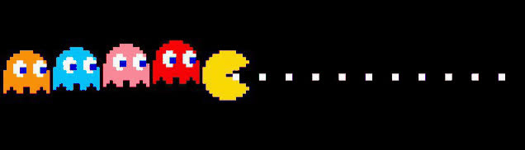

RESULTS
• Pac-Man game runs smoothly
• Ghosts chase autonomously
• Search algorithms work correctly
• Paths are clearly visualized
• System demonstrates AI behavior inside a maze
✔ All required outputs are achieved

Slide 9

This project demonstrates how AI search algorithms affect agent behavior.
We implemented a playable Pac-Man game with intelligent ghosts, real-time path visualization, and full algorithm comparison.
CONCLUSION

Slide 10

OUR TEAM
Loay Mohamed 238
Aya Eslam 241
Ali Amr 257
Judy Waleed 229
Ali Nagy 228

Slide 11


THANK YOU

